Slide 1


Slide 2

Clinic Management System

Slide 3



GROUP NO. 09
PYTHON:
Mini Project 1B
Department Of INFORMATION TECHNOLOGY
SEMESTER – IV
DIV: A
BRANCH: SE.IT

Slide 4
{Academic year 2021-22}
CLINIC MANAGEMENT System
S.E – I.T Engineering
Group Members:
AVINASH ANDHALE 20104138
VISHNUKANT MULE 20104065
PRATHAMESH NAIK 20104061
JEMIN BHANUSHALI 20104109
Under the Guidance of
Prof. Shital Agarwal

Slide 5
INTRODUCTION:
CLINIC MANAGEMENT SYSTEM is a project which aims is developing a computerized system to maintain all information of the Clinic Entities.
It has a facility of Admin Login through which the Admin can monitor the whole system.
Admin Modules are managing patients, manage Doctor’s, and manage Appointments
Patient Modules are to fill the registration form, Add details, find Doctor’s and applied for appointment, view appointment, view doctor prescription details.
Doctor Modules are to login, view appointments list, view patient details.
Overall this project of ours is being developed to help the Clinic Administration in the best possible way also reduce the human efforts.

Slide 6
OBJECTIVE:
The main objective of the project is to manage the records of the patients, doctor’s, and appointments.
Reduce the paper work and provides the 24x7 accessible website with the User-friendly GUI (Graphical User Interface) to manage the records.
Our objective is by using the system software the patient can easily search and view doctor Profiles and also apply for Booking a appointment.
It helps Doctors for viewing patient’s details.

Slide 7
PURPOSE:
To manage the Clinic Administrative work.
Helps patients to find the doctor details and Take appointments online from anywhere
This project also helps doctors work such as to keep information of patients and the appointments bookings per day, etc.

Slide 8
Scope:
This system which manages complete polyclinics details in a single application and in a single database.
The users will use this system to handle all the functionality easily. Admin will also use the system to keep track of the patients consulting to them.
The intentions of the system are to increase the number of patients that can be treated accurately.
Requirements statements in this document are non-functional.

Slide 9
SYSTEM REQUIREMENTS
SOFTWARE SPECIFICATION
Operating system : Support all Windows server
Front End : Pycharm (tkinter), Html
Back end : wamp server, MySQL

Slide 10
Clinic Management System
Admin
Doctor
Details
Patient
Doctor
Admin Login
Doctor-1
Doctor-2
Patient Registration form
Doctor Login
Admin Dashboard
Doctor-3
Doctor-4
Email OTP confirmation
Doctor Dashboard
Appointment Slot Booking

Slide 11
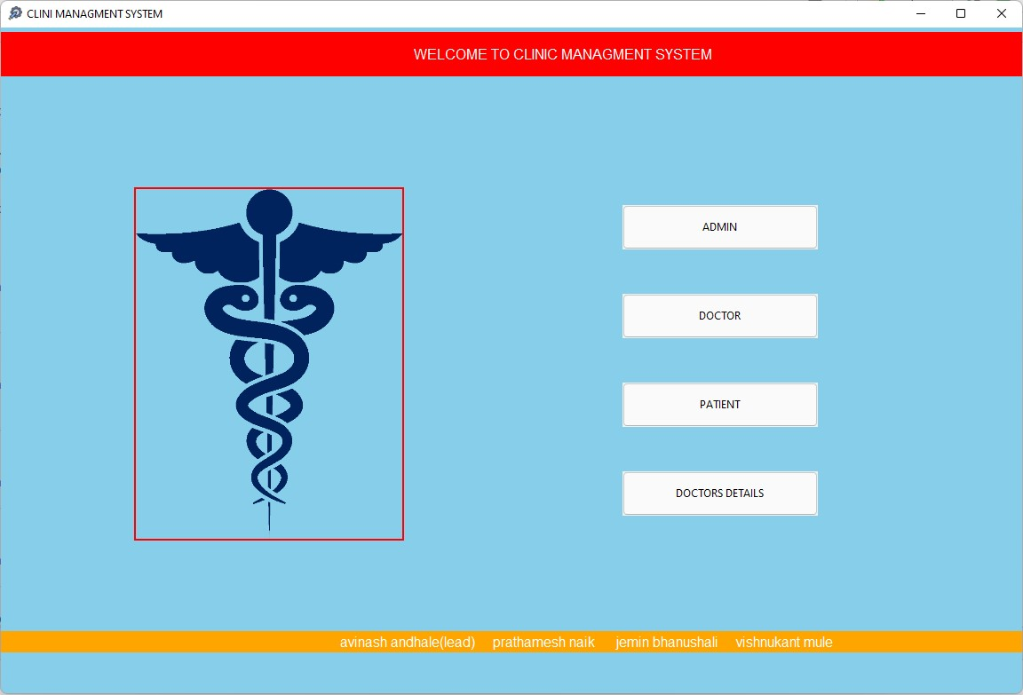

Slide 12
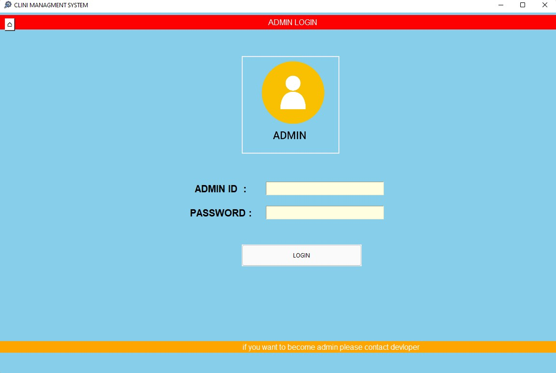
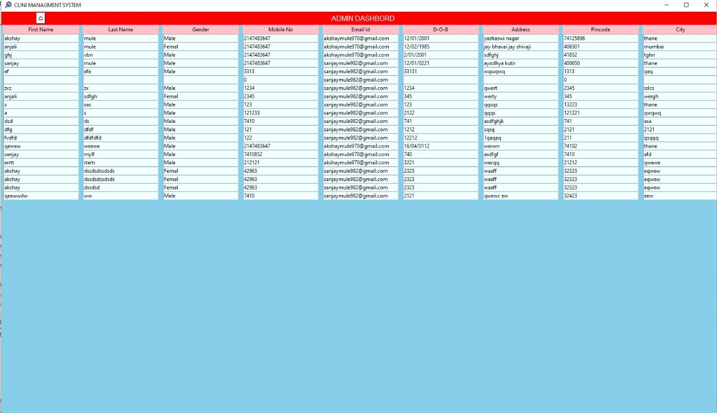

Slide 13
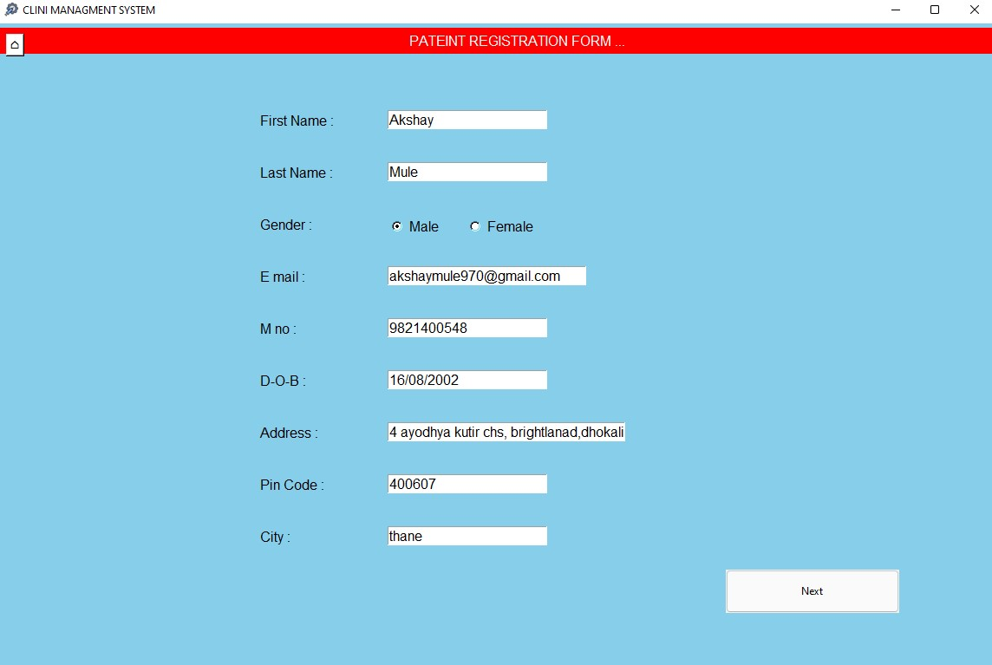
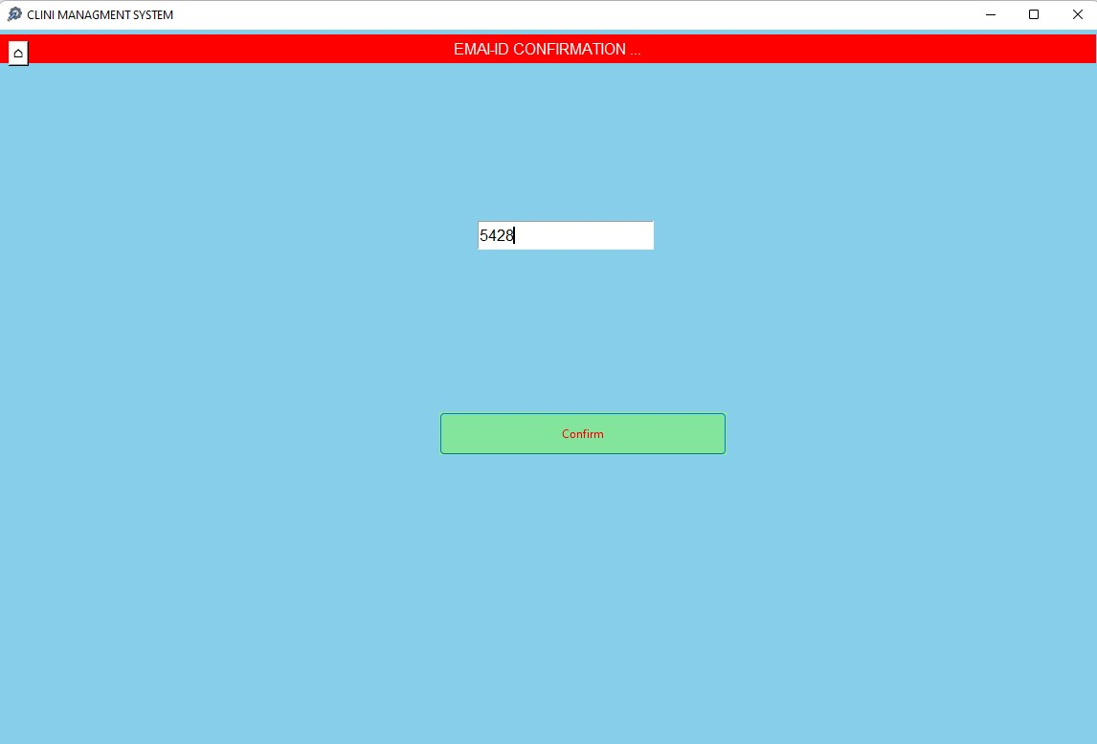

Slide 14
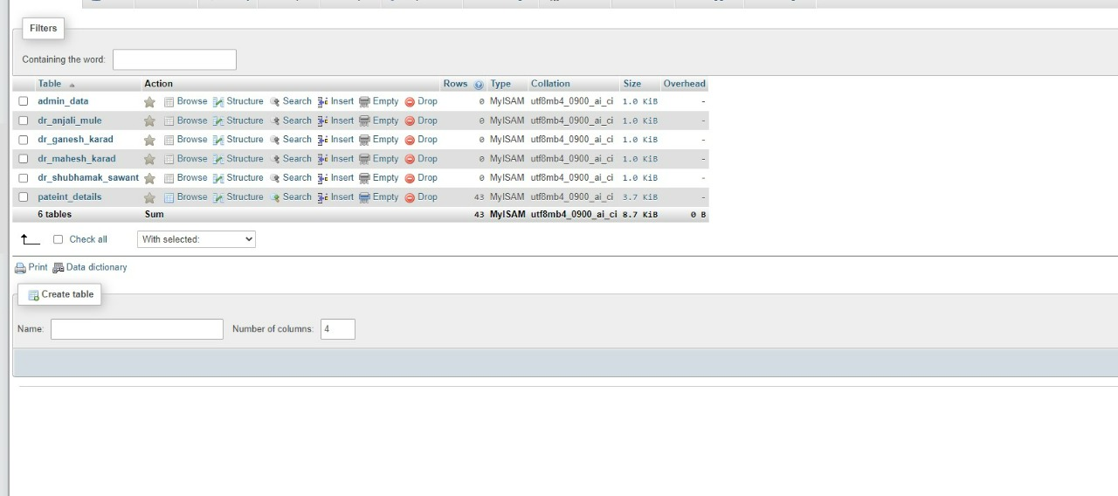
Database:

Slide 15
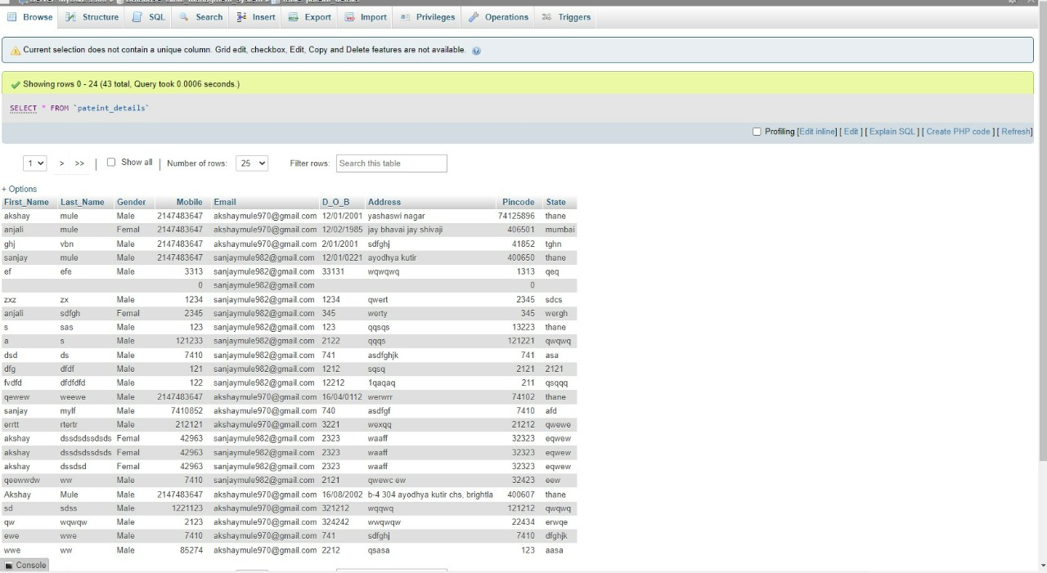

Slide 16
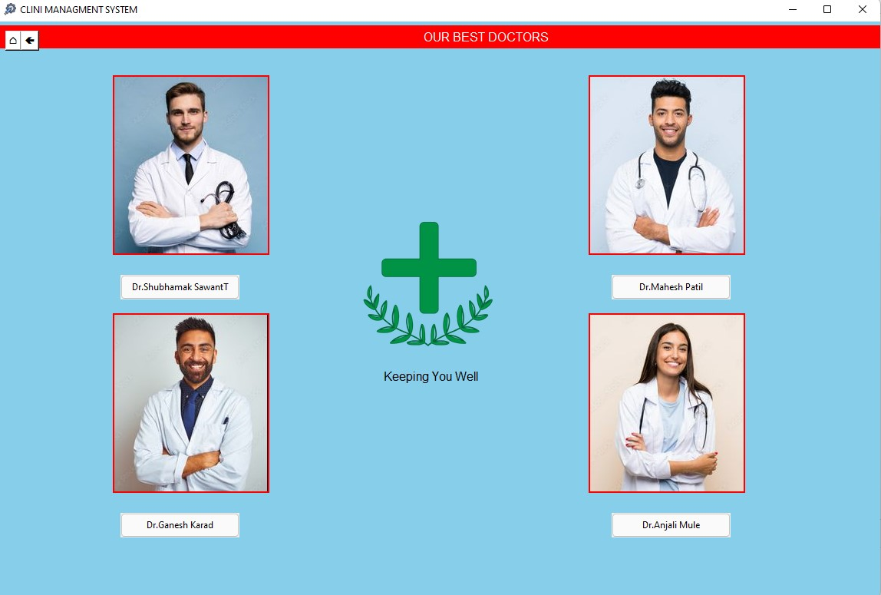
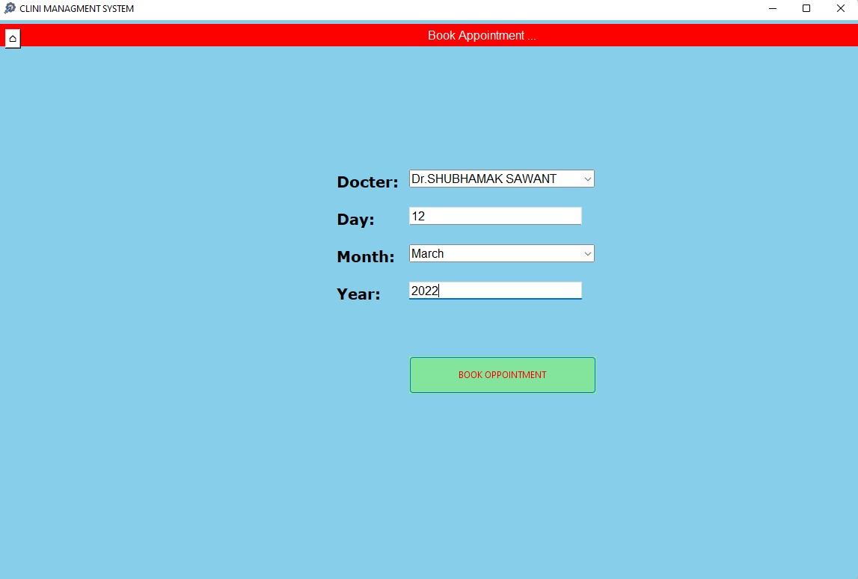

Slide 17
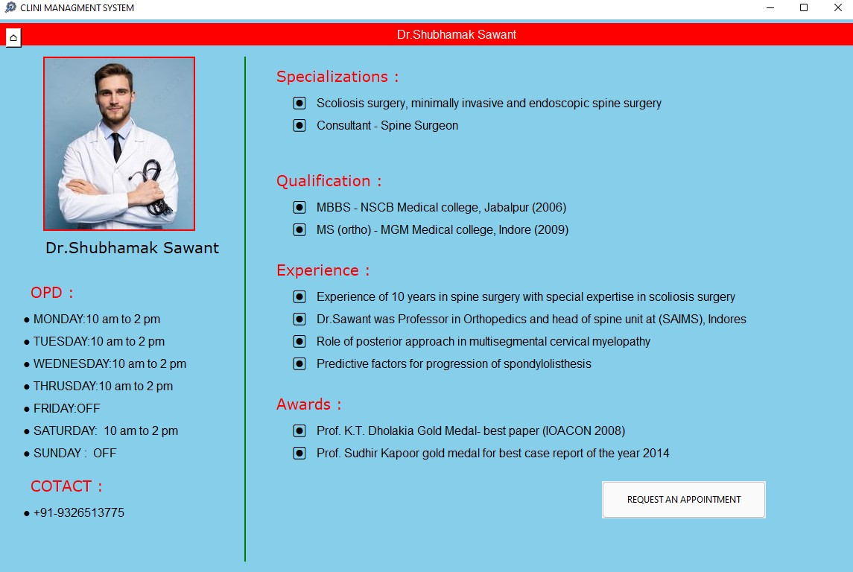

Slide 18
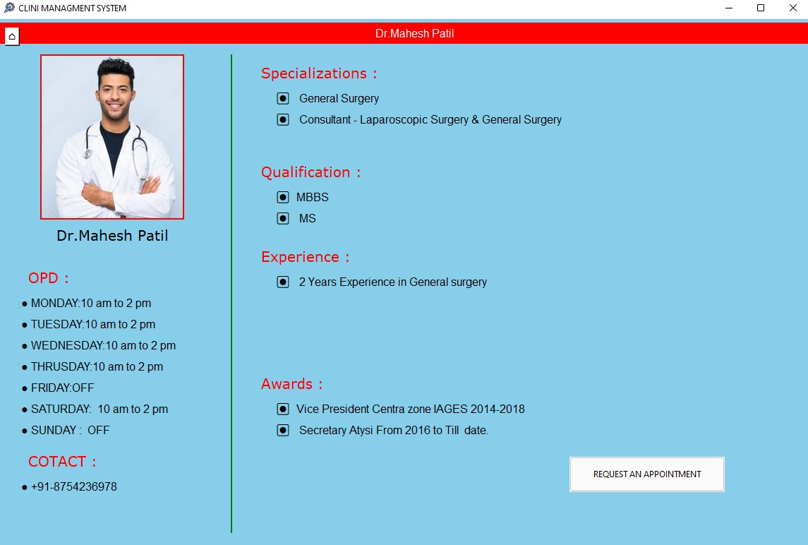

Slide 19
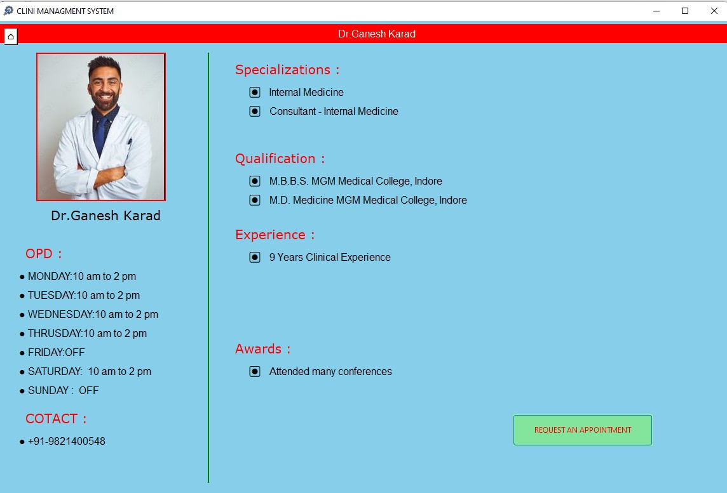

Slide 20
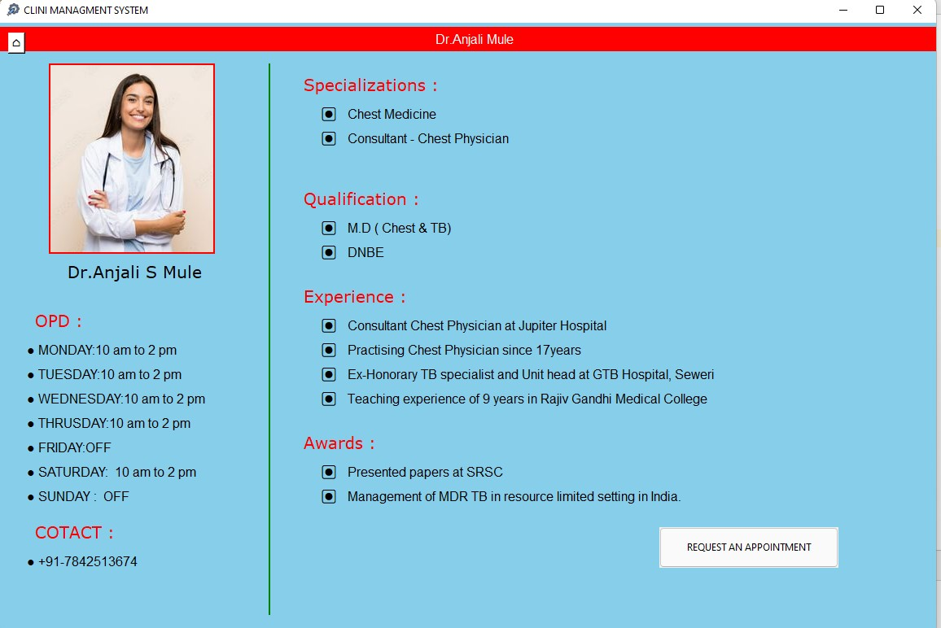

Slide 21
Conclusion:
Project introduction is the first step in building a system. Basically, it will tell what is the application or a system that we are intended to build, what it will look like, setting up the project scope, defining project objective, problem statements of the project and also the expected outcome. This stage will be used as a reference to ensure system meet the project scope and project objective.

Slide 22
THANK YOU..

Slide 23
Q. What is Clinic Management System ?
Clinic Management System (CMS), in short, is a Health-Tech software tool
that helps medical staffs such as doctors, nurses, and clinic assistants to better manage their clinic,
improve clinic efficiency, streamline clinic operations,
make accurate claims for patients,
reduce clinic expenditure and staff manual labor, and
provide patients with improved care.
An clinic management software plays an integral role in a clinic’s daily operations and is a must-have for doctors to provide high-quality treatment and care to their patients. ideal clinic software for you.

